Slide 1

Gold Loan Hypothesis
By- Virendra Raikwar

Slide 2
Introduction
This project focuses on hypothesis testing for the gold loan segment in finance. I currently work at Muthoot Fincorp, a well-known company with a long-standing reputation in gold loans. While Muthoot Fincorp offers a variety of financial products, the gold loan remains its primary offering. Gold loans are popular because they provide a secure and fast way to access funds. Since the COVID-19 pandemic, demand for gold loans has increased as people sought quick financial solutions, and our company has played a significant role in helping individuals during these times. Muthoot Fincorp continues to innovate and improve its offerings for our customers. This project leverages hypothesis testing to analyze data and understand customer behavior, which helps in creating better products that meet the needs of our clients.

Slide 3
Attention
All hypotheses in this project are tested on a synthetic dataset that I created, with data points generated randomly. Although these features were chosen to align with real-world relevance, the results may be biased due to the nature of synthetic data. I will interpret each hypothesis result based on my domain knowledge, but please keep in mind that outcomes are influenced by the data quality and structure. Domain knowledge helps in selecting important features and shaping the approach, yet the results may not fully represent real-world scenarios. Therefore, please don't judge my analysis solely by the hypothesis results.

Slide 4
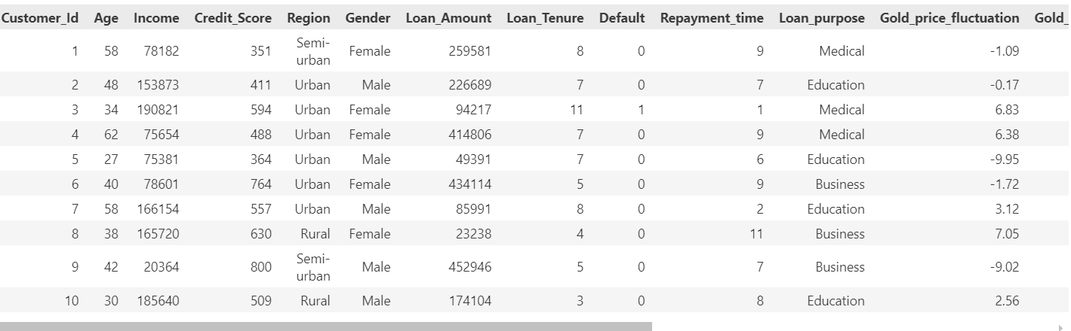
Loading Dataset

Slide 5
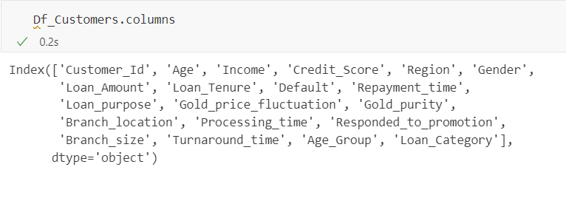
Checking Features

Slide 6
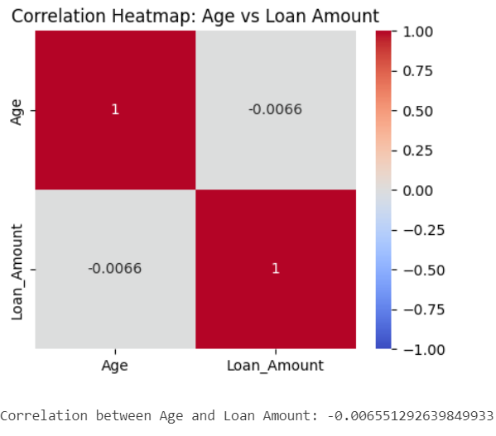
1.(i) Null Hypothesis (H₀): There is no correlation between customer age and loan amount. In other words, customer age does not affect the amount of loan taken. Alternative Hypothesis (H₁): There is a positive correlation between customer age and loan amount. Specifically, as customer age increases, the loan amount taken also tends to increase.
The null hypothesis is accepted here because the correlation is negative according to the data. In my experience in the gold loan segment, age does not impact the loan amount; instead, the key factors influencing the loan amount are the purity of the gold and the gold price on the given date.

Slide 7
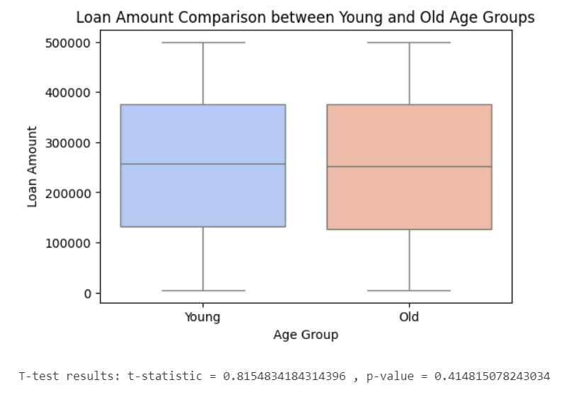
(ii)T-test
The t-test results indicate a t-statistic of approximately 0.82 and a p-value of 0.41. Generally, if the p-value is greater than a significance level (commonly set at 0.05), we fail to reject the null hypothesis.
Since the p-value (0.41) is much greater than 0.05, we do not have enough evidence to reject the null hypothesis. This suggests that there is no statistically significant difference between the means of the groups being compared.

Slide 8
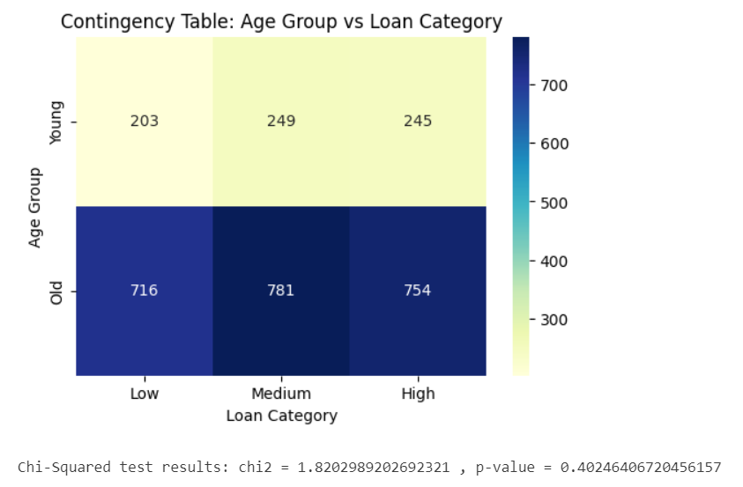
(iii) Chi-squares Test
The Chi-Squared test results show a chi-squared statistic of approximately 1.82 and a p-value of 0.40. In hypothesis testing, a p-value greater than the commonly used significance level (such as 0.05) means that we fail to reject the null hypothesis.
Since the p-value here (0.40) is greater than 0.05, we do not have sufficient evidence to reject the null hypothesis. This suggests there is no statistically significant association between the variables tested in this Chi-Squared test.

Slide 9
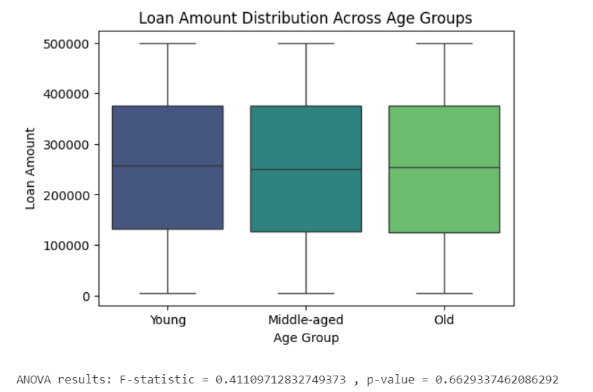
(iv) Annova Test
The ANOVA results indicate an F-statistic of approximately 0.41 and a p-value of 0.66. In ANOVA, a p-value greater than a typical significance level (like 0.05) suggests that we fail to reject the null hypothesis.
Since the p-value (0.66) is significantly greater than 0.05, we do not have enough evidence to reject the null hypothesis. This implies that there are no statistically significant differences between the means of the groups being compared in this ANOVA test.

Slide 10
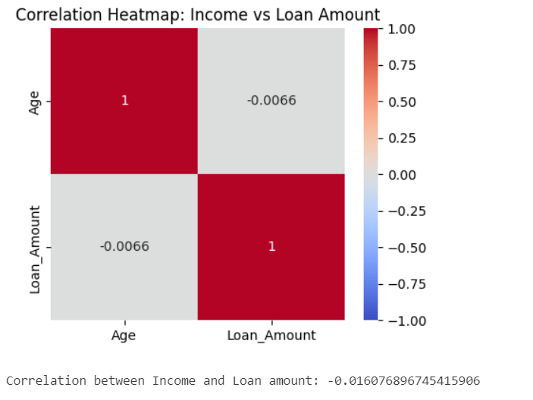
2. Null Hypothesis (H₀): There is no relationship between income level and loan amount. Higher-income customers do not take significantly larger loan amounts compared to lower-income customers. Alternative Hypothesis (H₁): There is a positive relationship between income level and loan amount. Higher-income customers take significantly larger loan amounts compared to lower-income customers.
The null hypothesis is accepted because the correlation is negative according to the data. However, this may not be accurate, as higher-income group customers tend to take larger loan amounts because they usually have more gold compared to lower-income group customers. Additionally, their needs are often greater, which may be for purposes such as business expansion or other financial requirements.

Slide 11
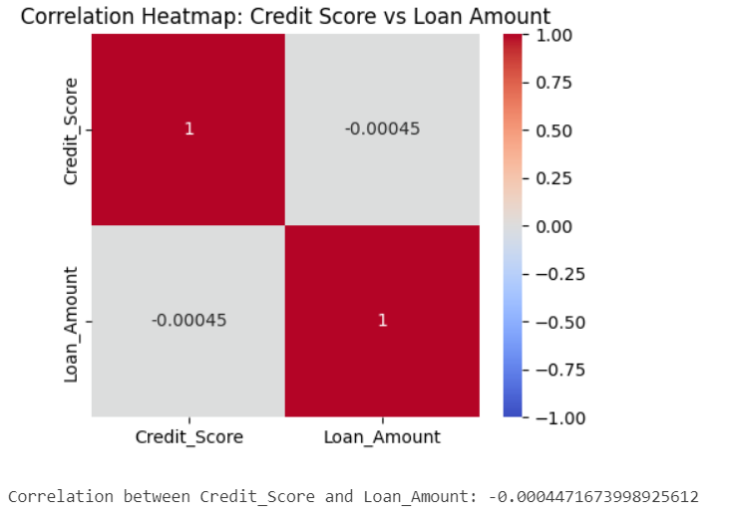
3. Null Hypothesis (H₀): There is no significant relationship between credit scores and loan amounts. (Higher credit scores are not associated with larger loan amounts.) Alternative Hypothesis (H₁): Higher credit scores are significantly associated with larger loan amounts.
The null hypothesis is accepted because the correlation is negative according to the data. In the gold loan segment, the credit score does not play an important role; instead, the quality and price of gold on that date primarily determine the maximum loan amount. However, in other segments, the credit score is crucial for securing the maximum loan amount and obtaining lower interest rates.

Slide 12
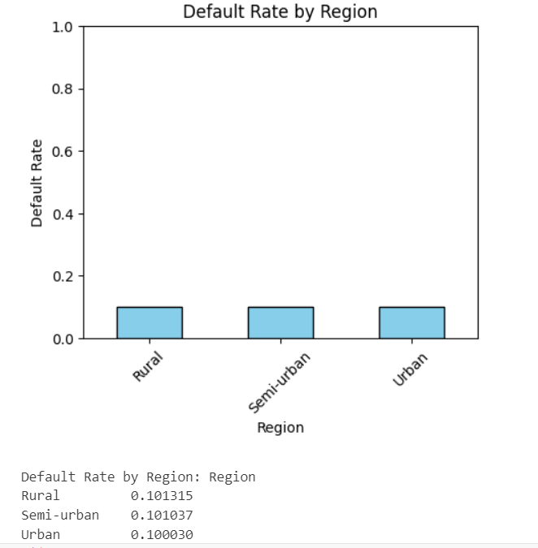
4. Null Hypothesis (H₀): There is no significant difference in default rates across different regions. Alternative Hypothesis (H₁): At least one region has a significantly higher default rate than others.
There is a slight variation in default rates across regions, with the rural area showing the highest default rate (10.13%) and the urban area showing the lowest (10.00%). However, these differences are minimal (less than 0.2% difference between the highest and lowest rates).

Slide 13
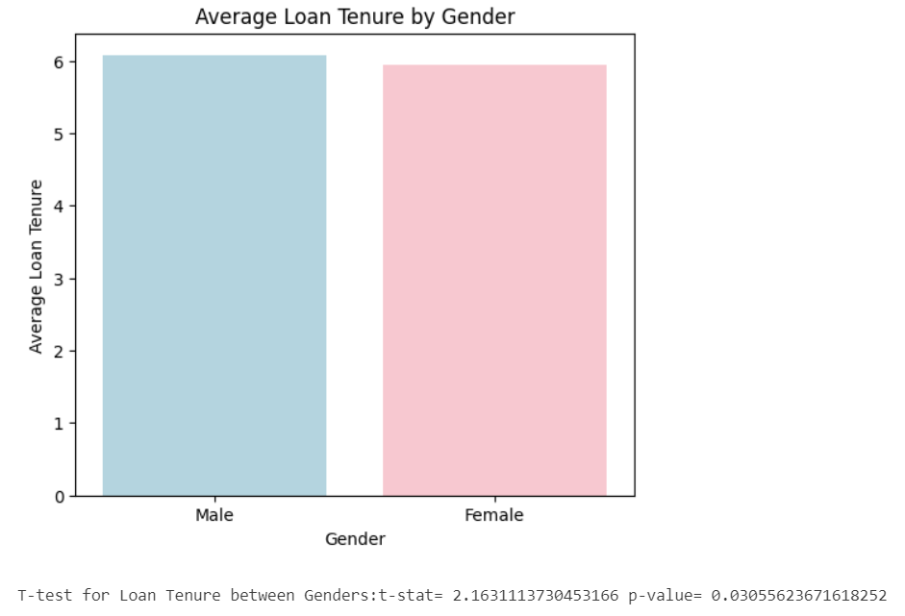
5. Null Hypothesis (H₀): There is no significant difference in loan tenure between male and female customers. Alternative Hypothesis (H₁): There is a significant difference in loan tenure between male and female customers.
Since the p-value is less than 0.05, we can reject the null hypothesis that there is no difference in loan tenure between genders. This result suggests that gender may have a statistically significant effect on loan tenure in this dataset, with the observed difference unlikely to be due to random chance. However, further investigation would be needed to understand the practical implications and any underlying factors contributing to this difference.

